Slide 1
Haz-Map
A Project to Map Occupational Toxicology Information into a Relational Database

Slide 2
Jay A. Brown, MD, MPH
Author of Haz-Map and Consultant for the National Library of Medicine and the Department of Labor

Slide 3
Outline of Talk
Haz-Map Basics
Precursor of Haz-Map
Information Sources
Updating the Database
Peer Review of Methods and Content
Conclusions

Slide 4
Chemicals Added to Database
First content added: 700+ chemicals from the NIOSH Pocket Guide.
Each chemical flagged for adverse effects.
Notes:
The first content added was information on about 700 chemicals from the NIOSH Pocket Guide to Chemical Hazards.
Using the yes/no fields in the Agents table, each chemical was flagged for the presence or absence of adverse effects as shown in the following table.

Slide 5
Controlled Vocabulary of Adverse Effects
Category | Adverse Effects
Lung Toxin | Asthma, Pneumonitis, Chronic Bronchitis, and Fibrosis
Neurotoxin | Neuropathy, Parkinson's Syndrome, and CNS Solvent Syndrome
Hematotoxin | Methemoglobinemia, Aplastic Anemia, and Hemolytic Anemia
Dermatotoxin | Contact Dermatitis, Chloracne, and Skin Burns
Carcinogen | Known, Probable, or Possible
Other Tissue Toxin | Hepatotoxin, Nephrotoxin, and Reproductive Toxin
Other Poison | Organophosphate, Carbamate, Organochlorine, Uncoupler, Chemical Asphyxiant, and Simple Asphyxiant
Notes:
So, what are the most important adverse effects of chemicals in occupational toxicology? In Haz-Map, there is a distinction between adverse effects (includes animal toxicology and human poisonings by ingestion cases) and occupational diseases (cases of workers made ill after inhalation or skin absorption). The first pass is to determine the adverse effect fingerprint for each chemical in the database. Is it a lung toxin? Is it a neurotoxin? And so on.

Slide 6
Distilling and Indexing Scientific Information
Distilling refers to the process of sifting through the information for inclusion or exclusion.
Only the most useful information is included.
The information should help the user to distinguish between significant and harmless exposures.
Given the user received a specific dose, what is the probability of harm?
Notes:
Examples of chemicals not included in Haz-Map are alloys, most drugs, and chemicals of cellular biochemistry.

Slide 7
Occupational Diseases Are Preventable If the Causes Are Correctly Identified
By removing the worker from exposure;
By removing the exposure from the workplace;
  Ban chemical;
  Enclose process;
  Establish exposure limit;

Slide 8
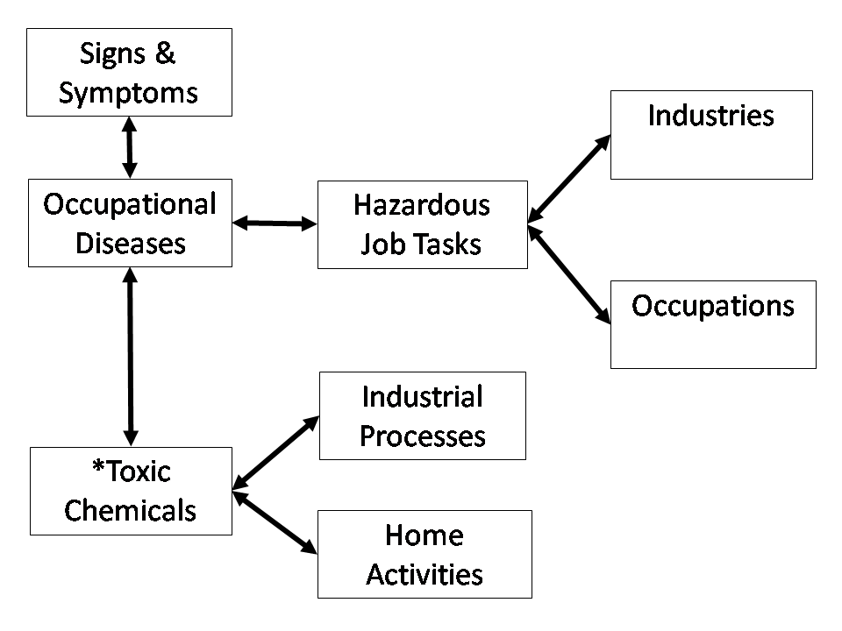
Eight Major Tables in Haz-Map
*Toxic chemicals include biological agents, e.g., latex rubber and grain dust.
Notes:
A relational database makes it easy to link information. Information about chemicals can be linked to information about diseases. The information for each occupational disease is developed once and periodically revised. A relational database is an efficient tool for managing complex information. Toxic chemicals include biological agents, e.g., latex rubber and grain dust.

Slide 9
Each Table Contains Records
235 Diseases | 7438 Agents (Chemicals)
227 Job Tasks | 54 Processes
277 Jobs | 27 Activities
624 Industries | 122 Findings
Notes:
The most time was spent on three tables: Chemicals, Diseases, and Job Tasks. The Chemicals (or Agents) table is the largest table with 7438 records. There were 2800 agents in August 2009 and 5998 in Jan. 2012. The Jobs and Industries tables are abbreviated versions of the SOC and NAICS standard coding classification systems, respectively.

Slide 10
The Chemicals Level
Processes
Chemicals
Activities
Notes:
The Chemicals table has 5998 records with each record having more than 50 fields. The fields are used to store information about the properties of the chemical, such as its vapor pressure (a number) and whether or not it is known to cause occupational asthma (yes or no). Because Haz-Map is a relational database, chemicals can be linked to industrial processes, for example, welding, and also to hobbies and other non-occupational activities explored in the occupational history. The bi-directional arrows mean that you can find all processes associated with lead or all chemicals associated with welding.

Slide 11
The Diseases Level
Findings
Jobs
Diseases
Job Tasks
Industries
Notes:
At this level, only the Diseases table is used directly in the SEM database. But the other tables are important indexes for mapping occupational toxicology. The diseases level of Haz-Map shows relationships between diseases and jobs or industries. The first step in building the content for the disease level of the database was to list and define the most important occupational diseases. Next, each disease was linked to one or more hazardous job task. In documented cases, what was the worker doing that caused the exposure to a sufficient dose that led to the disease? Finally, each job task was linked to the appropriate jobs and industries. Notice that hazardous job tasks are the intermediate link between occupational diseases and specific jobs or industries. Before looking at job tasks, I want to go back three slides to emphasize for you the most important relationship in Haz-Map for the SEM database, the agent-disease relationship.

Slide 12
Hazardous Job Tasks
A total of 227 job tasks and 277 jobs in Haz-Map.
Jobs in Haz-Map are defined by the SOC (Standard Occupational Classification) system.
A total of 2178 links between job tasks and jobs.
A few examples of hazardous job tasks are shown in the next two slides.

Slide 13
Examples of 227 Hazardous Job Tasks
Manufacture polyurethane products;
Remove insulation installed before 1975;
Extract coal;
Inhale dust of moldy hay, silage, straw or grain;
Notes:
Each job task is linked to one or more diseases and one or more jobs and industries. For example “Extract coal” is linked to 4 mining job titles and 3 coal industry titles as well as to 3 diseases: CWP, CWP (complicated), and COPD.

Slide 14

Examples of 227 Hazardous Job Tasks
Handle medical needles or surgical instruments;
Operate internal combustion engine with inadequate ventilation;
Repair or maintain gasoline or jet fuel tanks;
Remove lead coatings;

Slide 15
Precursor of Haz-Map
Sentinel Health Events

Slide 16
NIOSH Sentinel Health Events (Occupational)
SHE(O)s first published by Rutstein et al. in 1983 and updated by Mullan and Murthy in 1991.
64 occupational diseases linked to causal agents and associated industries.
“This list may serve as a framework for occupational health surveillance at the state and local level. It may also be used as a guide for practicing physicians caring for patients when there is a question of occupational illness.”

Slide 17
SHE(O)s Compared to Haz-Map
Occupational Diseases | SHE(O) | Haz-Map
Occupational Infections | 20 | 105
Occupational Cancer* | 13 | 19 (7 with no linked agents)
HP | 4 | 30
Other | 27 | 81 (7 SHE(O) diseases not added)
Total | 64 | 235
*In Haz-Map, all leukemias are combined and scrotal cancer is not listed separately from skin cancer.

Slide 18
SHE(O)s Compared to Haz-Map
SHE(O)s not in Haz-Map: silotuberculosis, tetanus, talcosis, agranulocytopenia, cerebellar ataxia, carpal tunnel syndrome, and mononeuritis.
In Haz-Map, but not in SHE(O) list: COPD, RADS, IVCD, oil acne, chloracne, contact urticaria, pneumoconiosis (benign & other), asphyxiation (simple & chemical), inhalation fever, metal poisoning (Mn, Cd, Cr, Hg, Pb, As) and other poisoning (fumigants, PCP, HF, DDT, and carbamates/organophosphates).
Notes:
IVCD = Irritant-induced Vocal Cord Dysfunction. Mullan & Murthy did not list diseases caused by metals separately but under diseases such as allergic contact dermatitis, renal failure, pneumonitis, asthma, and secondary Parkinson’s disease.

Slide 19
Information Sources
Scientific textbooks and Internet resources.
Notes:
See the handout, “Haz-Map Exposure Assessment: Main Web Pages, Websites, and Books.”

Slide 20
Haz-Map Sources of Information
Best and most up-to-date journals, monographs, textbooks, online databases, and websites;
Sources of information in Haz-Map are referenced. For example, the reference tag [Sullivan, p. 79] refers to the Sullivan & Krieger textbook.
See http://www.haz-map.com/refernc.htm for a complete bibliography and a list of all reference tags.
Notes:
Examples of websites with reference material are those of ATSDR, EPA, CDC, NIOSH, NLM, NTP, IARC, and OSHA.

Slide 21
Internet Resources
ChemIDplus
ExPub
Use these two portals to enter the name or CAS number of a chemical and to find information from many different websites.
Notes:
These are the two main portals I use to access toxicology information on the Internet.

Slide 22
Occupational Diseases
In which links between diseases and occupational exposures are established.
Notes:
See the handouts, “Occupational Diseases in Haz-Map” and the scientific paper, “Occupational Factors and Risk of Parkinson’s Disease: A Population-Based Case-Control Study.”
Explain 1st handout and why 2nd handout included.
"It is emphasized that not all epidemiological studies are equally informative or of equal quality. Some have low statistical power and provide little information on risks; others are so susceptible to potential or actual biases that findings have little or no validity. It is important to consider methodological issues when interpreting the evidence from different studies, and it is the consistency of findings in different studies conducted by different investigators in different parts of the world that is most informative." [John Boice. "Ionizing Radiation" in Schottenfeld, p. 281]

Slide 23
Metals and Occupational Diseases
Disease Name | Caused by Compounds Containing
Toxic Neuropathy | As (inorganic); Tl; Pb; Hg
Pneumoconiosis, Other | Sb; Rare Earth Metals
Pneumoconiosis, Benign | Fe; Ba; Sn; Sb; Rare Earth Metals
Parkinsonism | Mn
Bone Cancer | Pu; Ra
Nasal Sinus Cancer | Ni; Ra
Skin Cancer | As (inorganic)
Occupational Asthma | Cr(VI); Ni
Contact Dermatitis, Allergic | Ni; Cr(VI)
Acute Tubular Necrosis | Cr(VI); U; Pb
Chronic Renal Failure | Cd; Pb
Notes:
All metal compounds are linked to the respective diseases as shown in this table.

Slide 24
Health Effects of Ionizing Radiation
See the chapter on “Ionizing Radiation” by John D. Boice, Jr. in Cancer Epidemiology and Prevention, edited by Schottenfeld & Fraumeni.
“Fourteen epidemiologic studies have been conducted of more than 120,000 workers at uranium processing, enriching, metal fabrication, and milling facilities. These studies overall found no cancer to be significantly increased.” [Boice, p. 274]

Slide 25
Chemicals Linked to Occupational Cancer
See the chapter on “Occupation” by Siemiatycki, Richardson, and Boffetta in Cancer Epidemiology and Prevention, edited by Schottenfeld & Fraumeni.
“Over the past 50 years, it is likely that the number of occupationally induced cancers has decreased in western countries.” [Siemiatycki, p. 344]

Slide 26
Updating the Database
Continually reviewing and redrawing the map.

Slide 27
Adding and Updating Chemical and Disease Profiles
All textbook references are reviewed when new textbook editions are published.
A review of 663 chemicals added to Haz-Map in the 1990s was completed 3/8/2008.
Another review of 156 chemicals added in the 1990s was completed 10/14/2011.
2400 chemicals from the HSDB database were added to Haz-Map in 2010.
Ten diseases and approximately 600 chemicals were added in 2011.
Notes:
See the “Agent Categories” handout.

Slide 28
2002 Review of Journals
A review of selected epidemiology and occupational medicine journals for the period of 1998-2002 yielded 696 abstracts and 216 full-text articles.
As a result of the review, some content was changed and hyperlinks to PubMed abstracts were added.
Notes:
Changes made during a review include chemical structures, synonyms, vapor pressures, lethal concentrations, Sources/Uses, adverse effects, and associated Processes and Diseases.

Slide 29
2008 Review of Journals
Reviewed were all articles from Jan. 2005 through May 2008 in: Am J Ind Med, Chest, Int Arch Occup Environ Health, J Occup Environ Hyg, J Occup Environ Med, Occup Environ Med, and Scand J Work Environ Health.
284 papers selected to read and add to Haz-Map in the categories: Beryllium (12), Respiratory Diseases, (24), Solvents (16), Neurodegenerative Diseases, (4), Pesticides (4), Benzene (2), Welding (7), Toxicology (3), Cancer (49), Metals (28), OA (30), PFTs (7), Jobs (15), Farming (13), Silica (21), HP (9), CWP (4), and Other (36).

Slide 30
2011 Review of Journals
The same journals as in 2008 from 6/08 through 1/11 were reviewed.
Of the 256 articles selected to read, 13 were added as Haz-Map hyperlinks, 17 to a PubMed list on my website, and 56 as PMID references in Haz-Map text.
Notes:
Same journals as 2008.

Slide 31
More Research Needed
I looked for diseases and agents not in Haz-Map—checked 7 occupational medicine textbooks plus Schottenfeld and read about 200 papers retrieved from PubMed.
These are diseases with no established chemical causes in the occupational setting: atherosclerosis, hypertension, solvent-induced hearing loss, porphyria cutanea tarda, rheumatoid arthritis, and scleroderma.
None of these diseases were listed as SHE(O)s in the 1991 paper by Mullan and Murthy.

Slide 32
Peer Review of Haz-Map Methods and Content
Digital and Analog Textbooks
Notes:
See the peer-reviewed paper, “An Internet Database for the Classification and Dissemination of Information About Hazardous Chemicals and Occupational Diseases.” How is Haz-Map like a digital textbook? And, how is the peer review of a medical textbook similar to the peer review of Haz-Map?
See “How can we get the best out of peer review?” and “Does peer review mean the same to the public as it does to a scientist?” at http://www.nature.com/nature/peerreview/debate/.

Slide 33
Not Like Editing a Textbook
Create the index (controlled vocabulary) first, instead of making the index at the end.
Publish the next edition in a few months rather than in a few years.
Update information using the software (Microsoft Access) to sort or find by any field, e.g., CAS #, formula, synonym, or category.
Use hyperlinks to connect to PubMed abstracts or to other web pages, e.g., EPA, OSHA, NIOSH, or IARC.
Notes:
Read after 3rd bullet: For example, one can use the text filter “contains” to find all records in which the chemicals have “Cd” in their formulas. One can also see all chemicals in the category “Aldehydes” or “Chlorophenols.”

Slide 34
Like Editing a Textbook
The editor chooses which information to include or exclude.
The editor requires that all references are up to date and from the peer-reviewed literature.
The editor ensures that all chapters are written clearly, topics are covered in a consistent manner, and indexing is accurate.
After completion, the editor submits the new edition to a publisher for final layout design and copy editing.

Slide 35
Haz-Map Review Environment Since 2000 (NLM) and 2006 (DOL)
Reviewed monthly in teleconferences with DOL and Paragon professional staff.
New chemical profiles reviewed by Ann Gravatt, who has worked for many years on NLM’s HSDB, and Paragon’s Bernie Kokenge, PhD (chemistry).
Mike Hazard, PhD (chemistry) and author of ChemIDplus, reviewed information in Haz-Map when it was first published in 2002.
Bert Hakkinen, PhD (toxicology) has reviewed Haz-Map topics in his work at NLM since 2008.
Notes:
Haz-Map was built on a foundation of strong toxicology databases like HSDB and others that can be found in ChemIDplus. Haz-Map has been presented by NLM staff in the Specialized Information Services (SIS) at many conferences around the US and at some international conferences. Staff members forward to me any feedback received from users. So, this describes some of the environment in which Haz-Map has been developed and reviewed over the years.
Haz-Map was cited in a IOM report "Incorporating Occupational Information in Electronic Health Records." The report mentions Haz-Map in "Box 1" and also in "Box 6" in the "Examples of Online Databases with Information on Health Effects of Hazardous Exposures."

Slide 36
Conclusions
Haz-Map is a peer-reviewed and scientifically rigorous database of toxic chemicals and preventable occupational diseases.
Diseases are included only if there is sufficiently robust evidence that occupational exposure can cause the diseases, and therefore, that the diseases can be prevented by good occupational hygiene practices.
It is up to future mapmakers to build a better map and to fill in the details as more complete knowledge is discovered.
Notes:
See “Toxicology and epidemiology: improving the science with a framework for combining toxicological and epidemiological evidence to establish causal inference” by the Dept. of Epidemiology, Harvard School of Public Health. “The causal relationship grid provides a clear view of how epidemiological and toxicological data intersect, permits straightforward conclusions with regard to a causal relationship between agent and effect, and can show how additional data can influence conclusions of causality.” [PMID 21561883]

